Slide 1
Database Systems
Streaming Platform Car Accident
Team:
Kishan Byrosu (IR8803)
Shiva Sai Sampath Kumar (UK1017)
Bhuvana Prakash (TI5686)

Slide 2
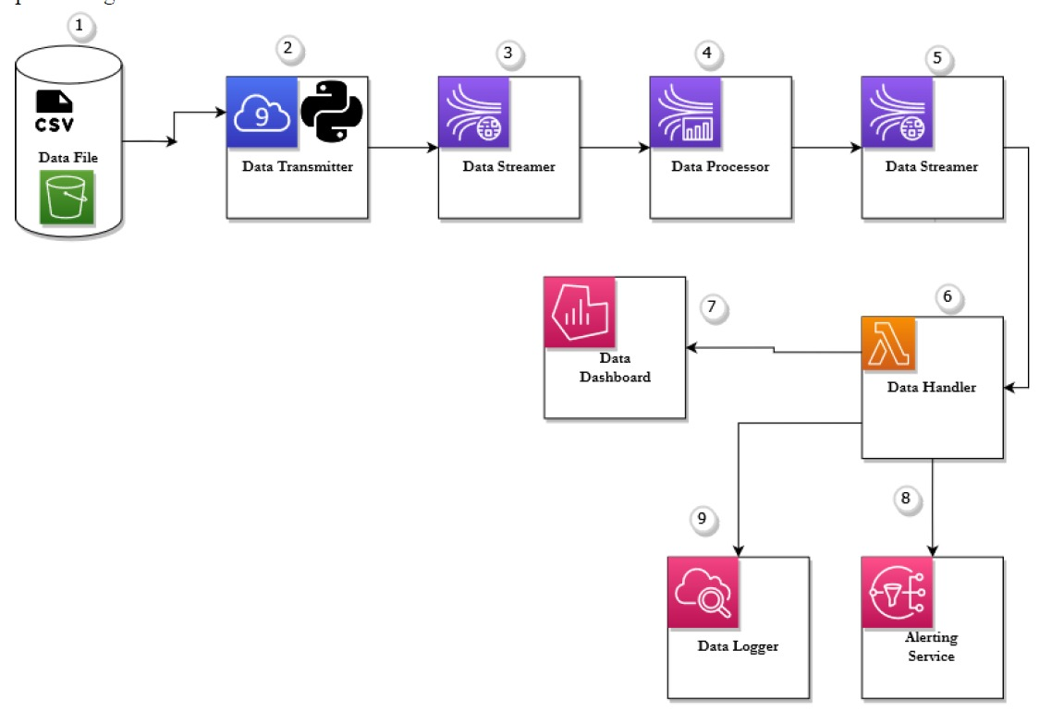

Slide 3
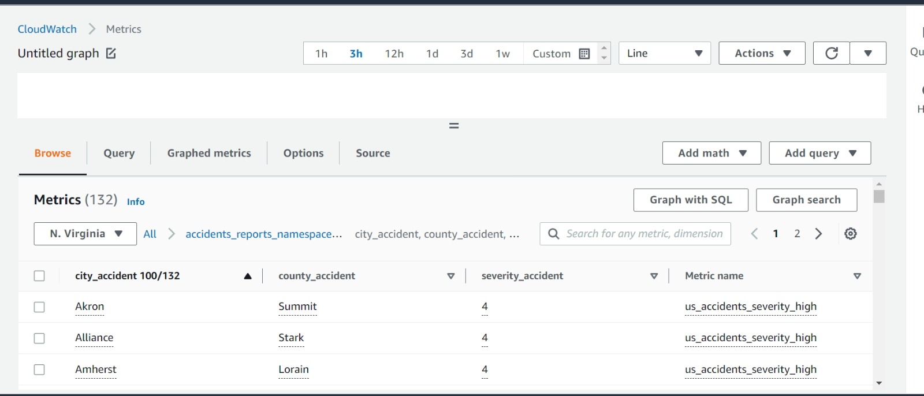

Slide 4
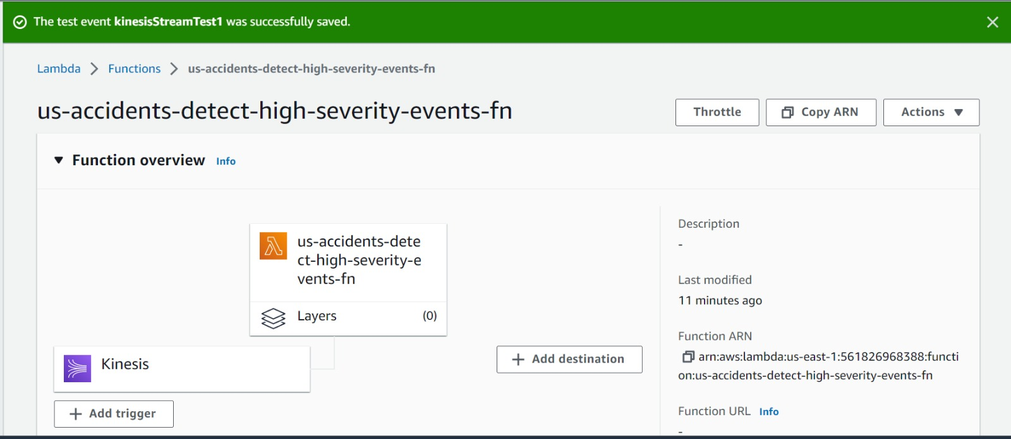

Slide 5
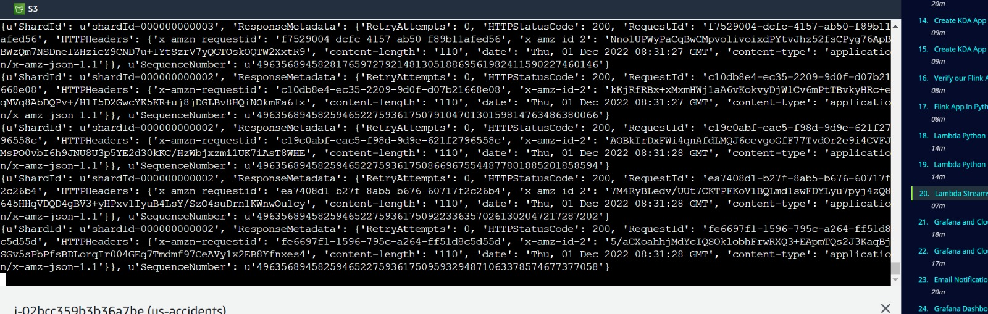

Slide 6
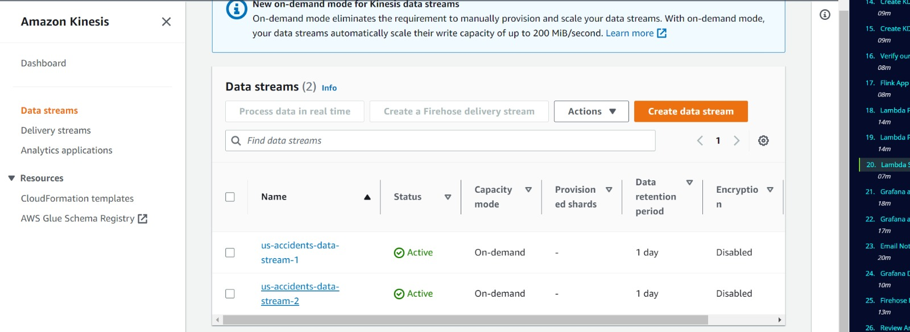

Slide 7
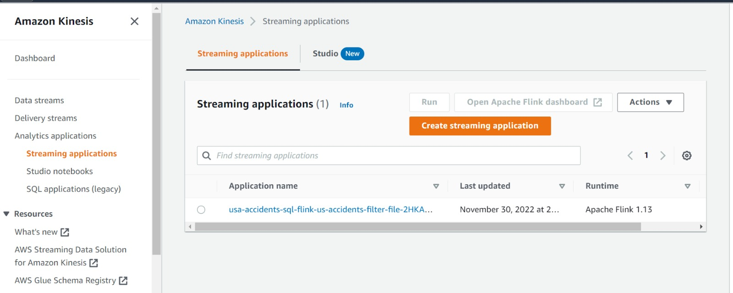

Slide 8
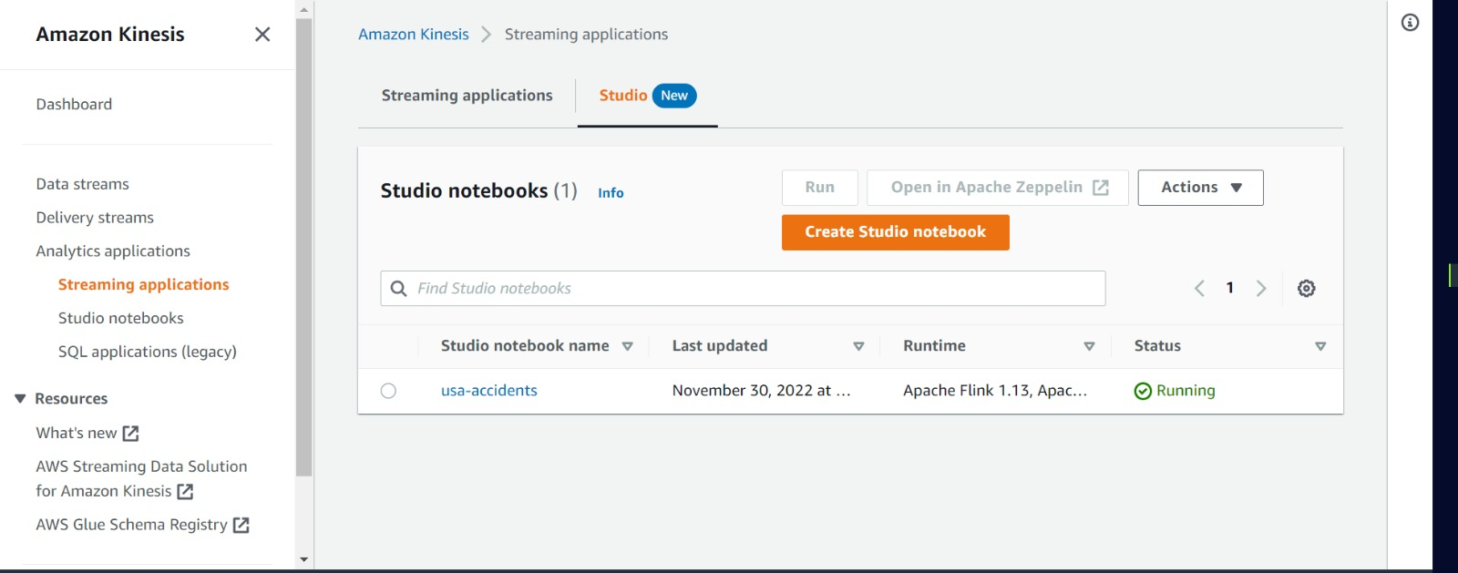

Slide 9
